Slide 1
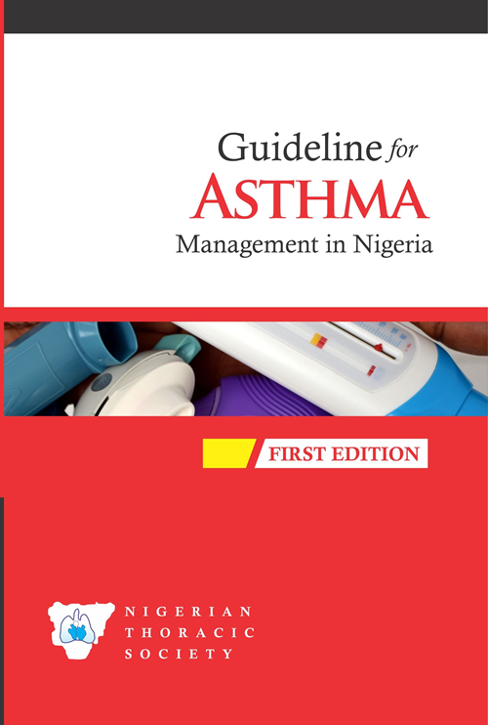
HOW THE NIGERIAN ASTHMA GUIDELINE WAS DEVELOPED

Slide 2

WHAT ARE GUIDELINES?
The Institute of Medicine defines clinical practice guidelines as "…statements that include recommendations, intended to optimize patient care, that are informed by a systematic review of evidence and an assessment of the benefits and harms of alternative care options" [1].
1. Consensus report, Institute of Medicine. Clinical practice guidelines we can trust. March 23, 2011. http://www.iom.edu/Reports/2011/ Clinical-Practice-Guidelines-We-Can-Trust.aspx

Slide 3
WHAT ARE GUIDELINES?
Clinical guidelines are “systematically developed statements to assist practitioner and patient decisions about appropriate health care for specific clinical circumstances.”¹
Field MJ, Lohr KN, editors. Clinical practice guidelines: directions for a new program. Washington, DC: National Academy Press; 1990.

Slide 4
They offer concise instructions on which diagnostic or screening tests to order, how to provide medical or surgical services, how long patients should stay in hospital, or other details of clinical practice.

Slide 5
WHY DO WE NEED GUIDELINES?
To provide standardized care
To improve quality of care
To translate new research findings into clinical practice
To reduce inappropriate variation in practice
To create protocols and clinical pathways for physicians and healthcare institutions

Slide 6
WHY DO WE NEED GUIDELINES?
To give a structured approach to healthcare
To promote efficient use of resources
To act as focus for quality control, including audit
To give specific recommendation that is international and can be adapted locally.
Wollersheim H, Burgers J, Grol R. Clinical guidelines to improve patient care. Neth J Med. 2005 Jun;63(6):188-92.

Slide 7

HOW THE GUIDELINE WAS DEVELOPED
We followed the internationally recommended procedure for developing guidelines.
Contributors were chosen from various regions of the country based on their area of expertise, published work and experience in the management of asthma.
The guideline was subjected to local and international peer-review.
Editorial work was carried out by the secretariat of the Asthma Guideline

Slide 8
DEVELOPING THE NIGERIAN ASTHMA GUIDELINE: IMPORTANT TIMELINES
Inauguration of the asthma guideline committee members | November 2015
Initial mails to all committee members | December 2015
Division of guideline into different chapters | January 2016
Exchange of several mails and conference calls | Jan-Feb 2016
First draft received from contributors | March 2016
Second draft received from contributors | April 2016
Meeting of the working committee ,(Lagos) | May 2016
Manuscript sent out to local and international reviewers | June 2016
A completed manuscript was shown to the NTS during the AGM in Ibadan for comments and contributions | November 2016
Further editorial work | January 2017
Final editorial review | March 2017
Printing | April ,2017

Slide 9
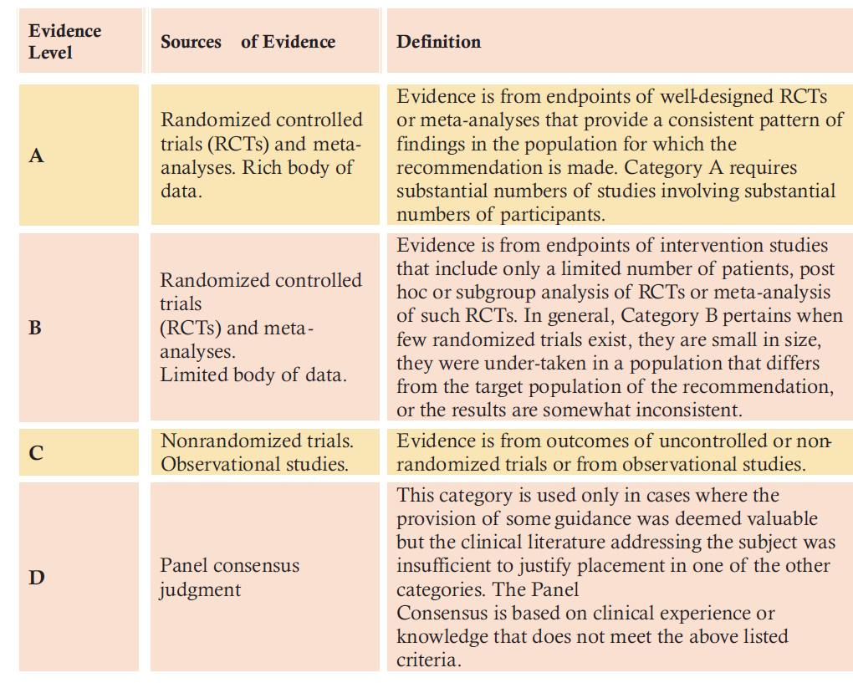
DESCRIPTION OF LEVELS OF EVIDENCE USED IN THIS GUIDELINE

Slide 10
GOALS OF MANAGEMENT
RAPID REVERSAL OF SEVERE HYPOXAEMIA AND IMPROVE VENTILATION/PERFUSION.
REVERSE BRONCHO-CONSTRICTION AND IMPROVE LUNG FUNCTION RAPIDLY.
REDUCTION OF THE RISK OF RELAPSE BY INTENSIFYING THERAPY AND MONITORING RESPONSE
PREVENTION OF COMPLICATION AND ADVERSE REACTIONS OF MEDICATIONS.

Slide 11
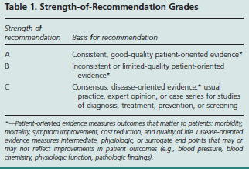

Slide 12
